Slide 1

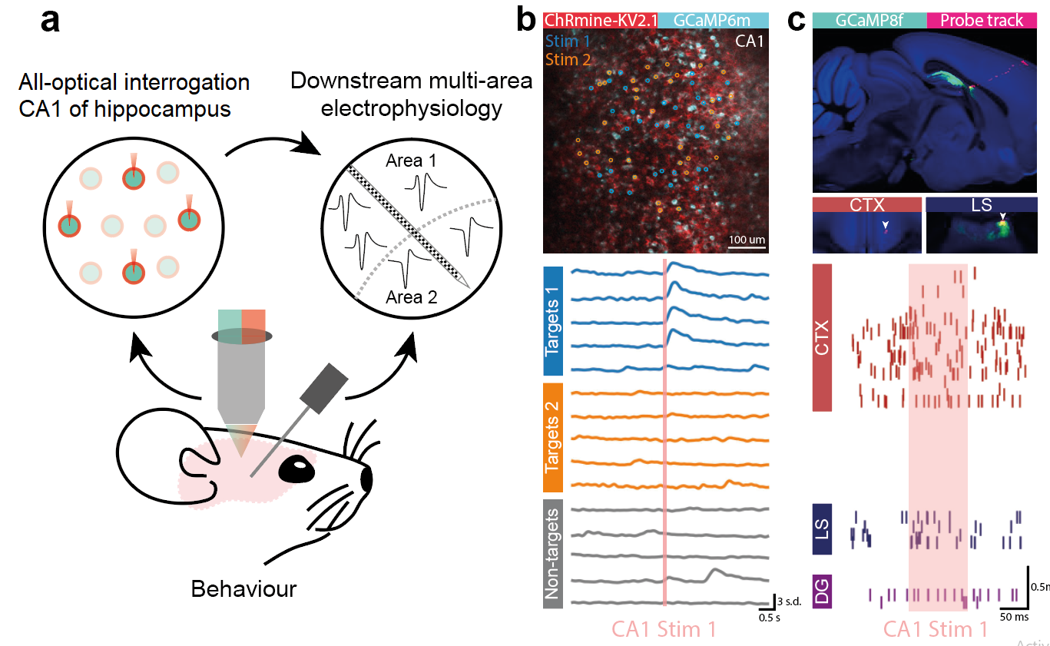
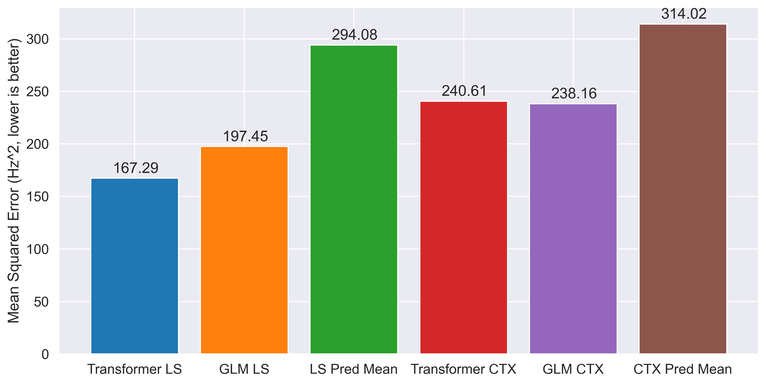
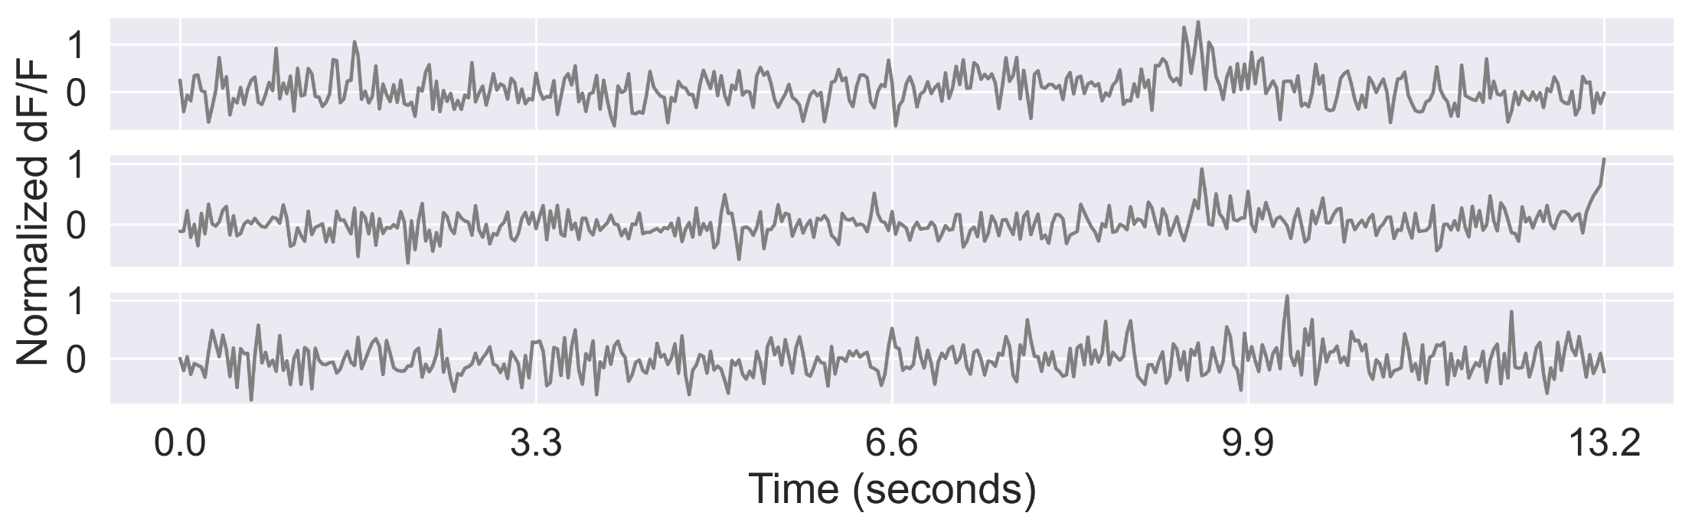
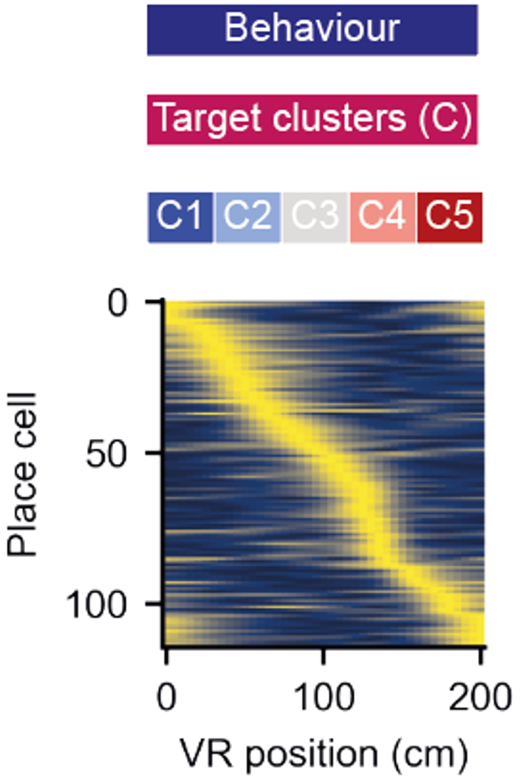
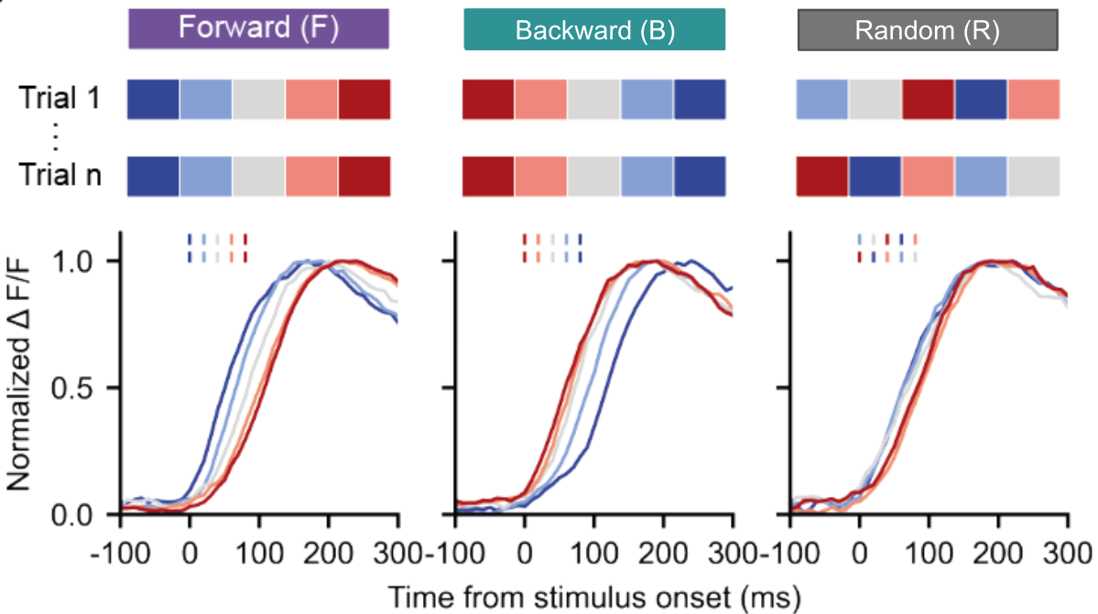
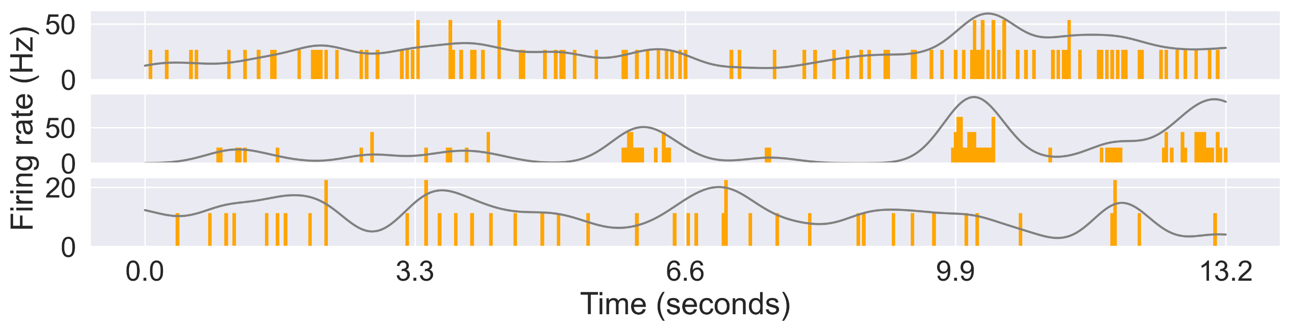
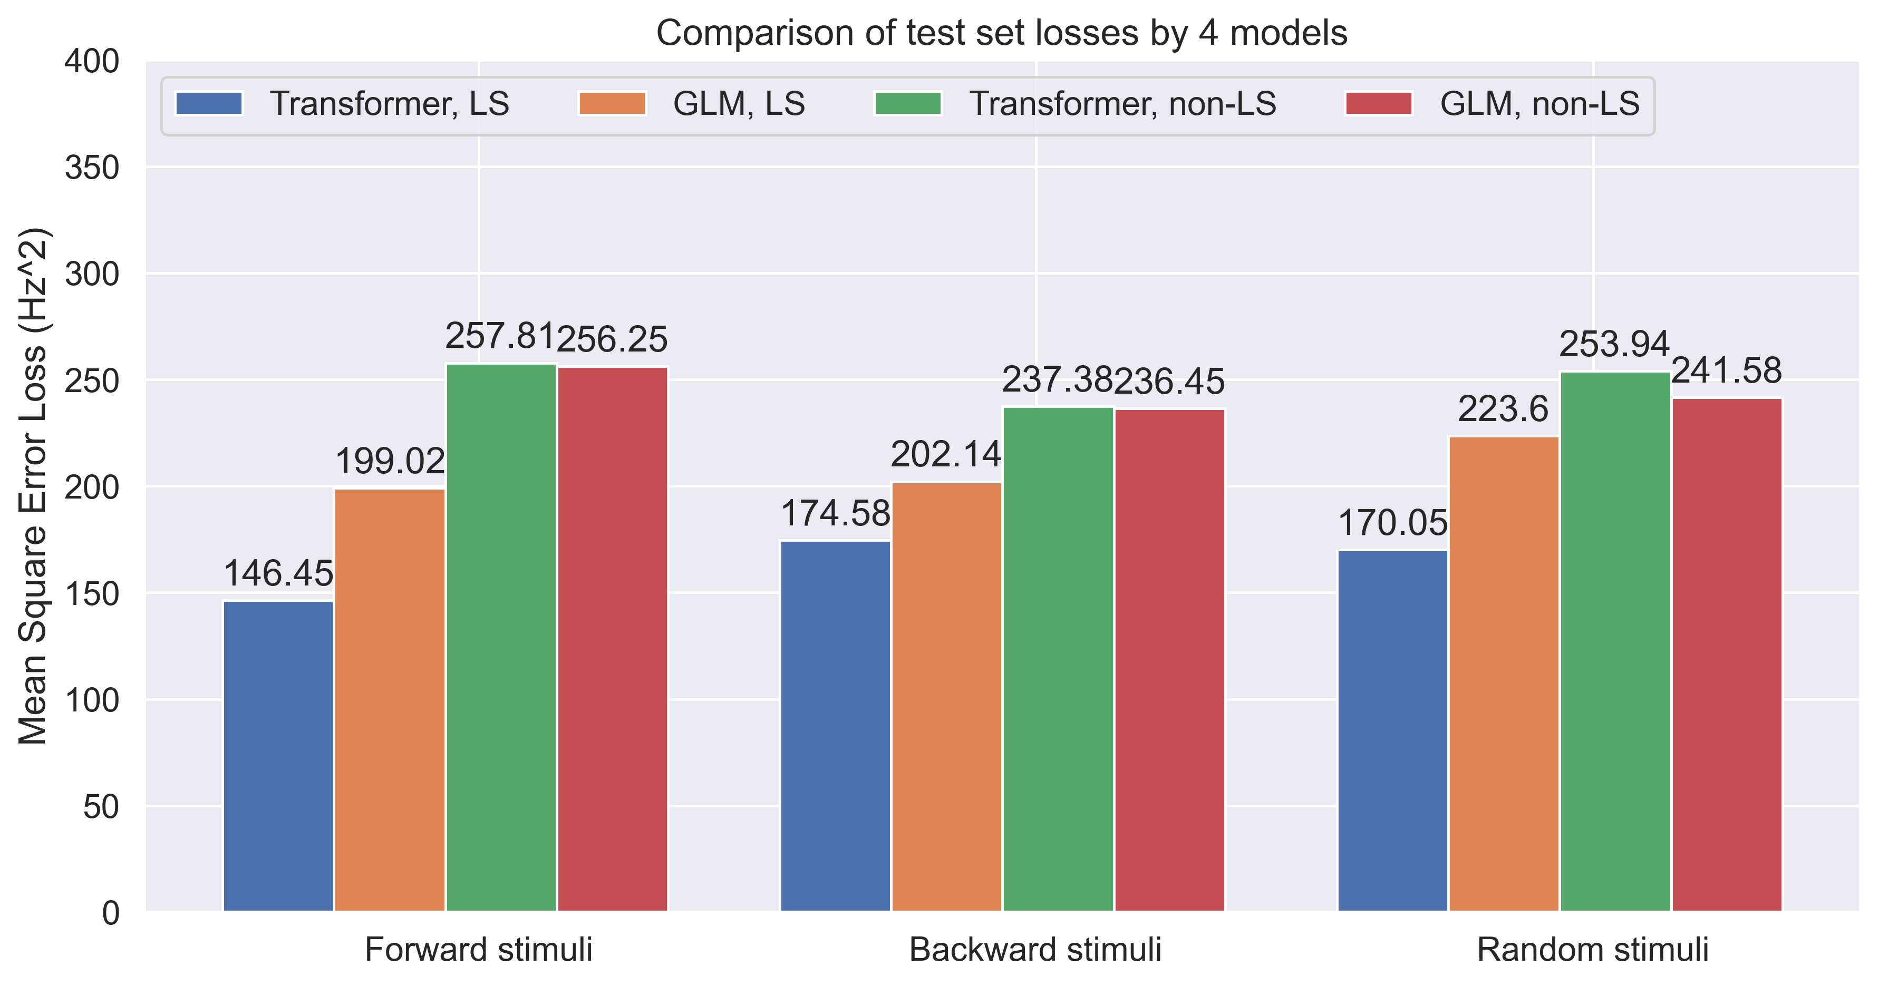
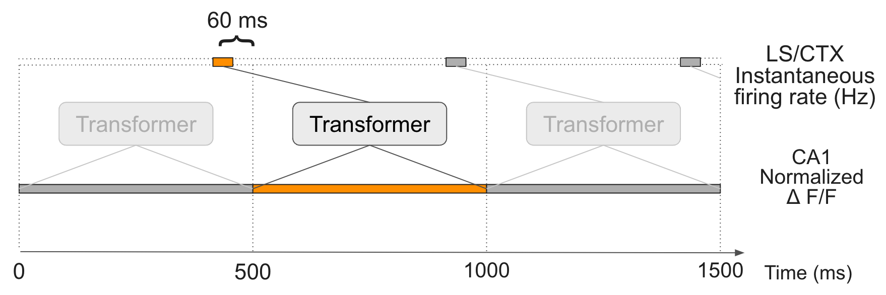
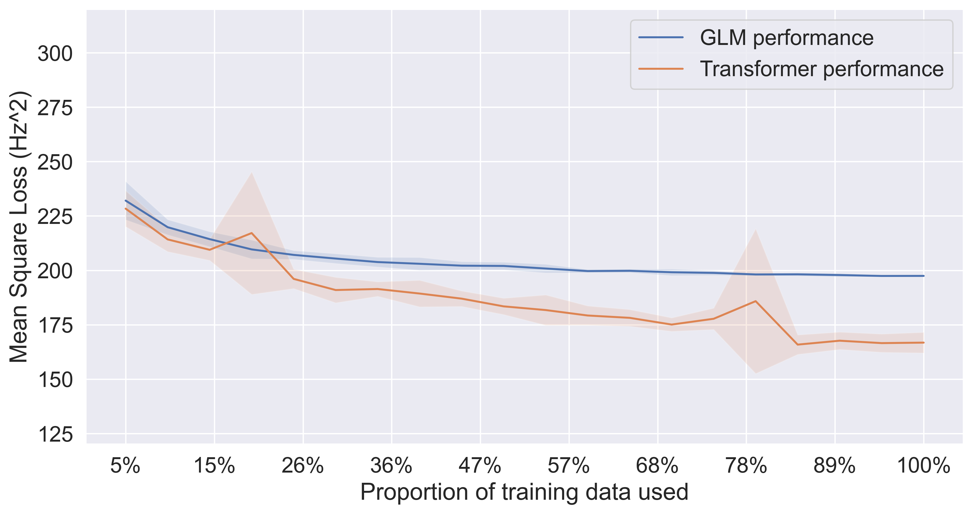
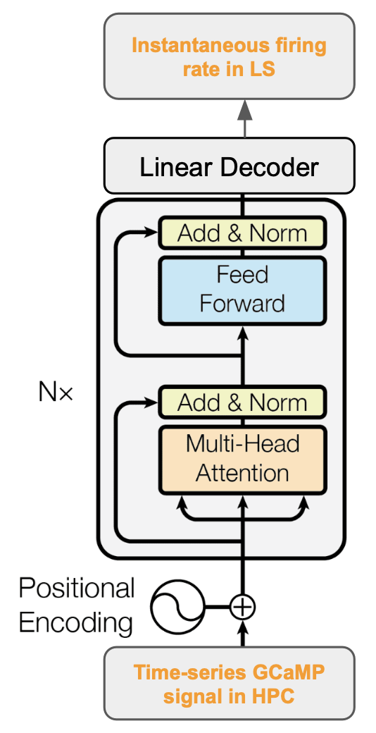
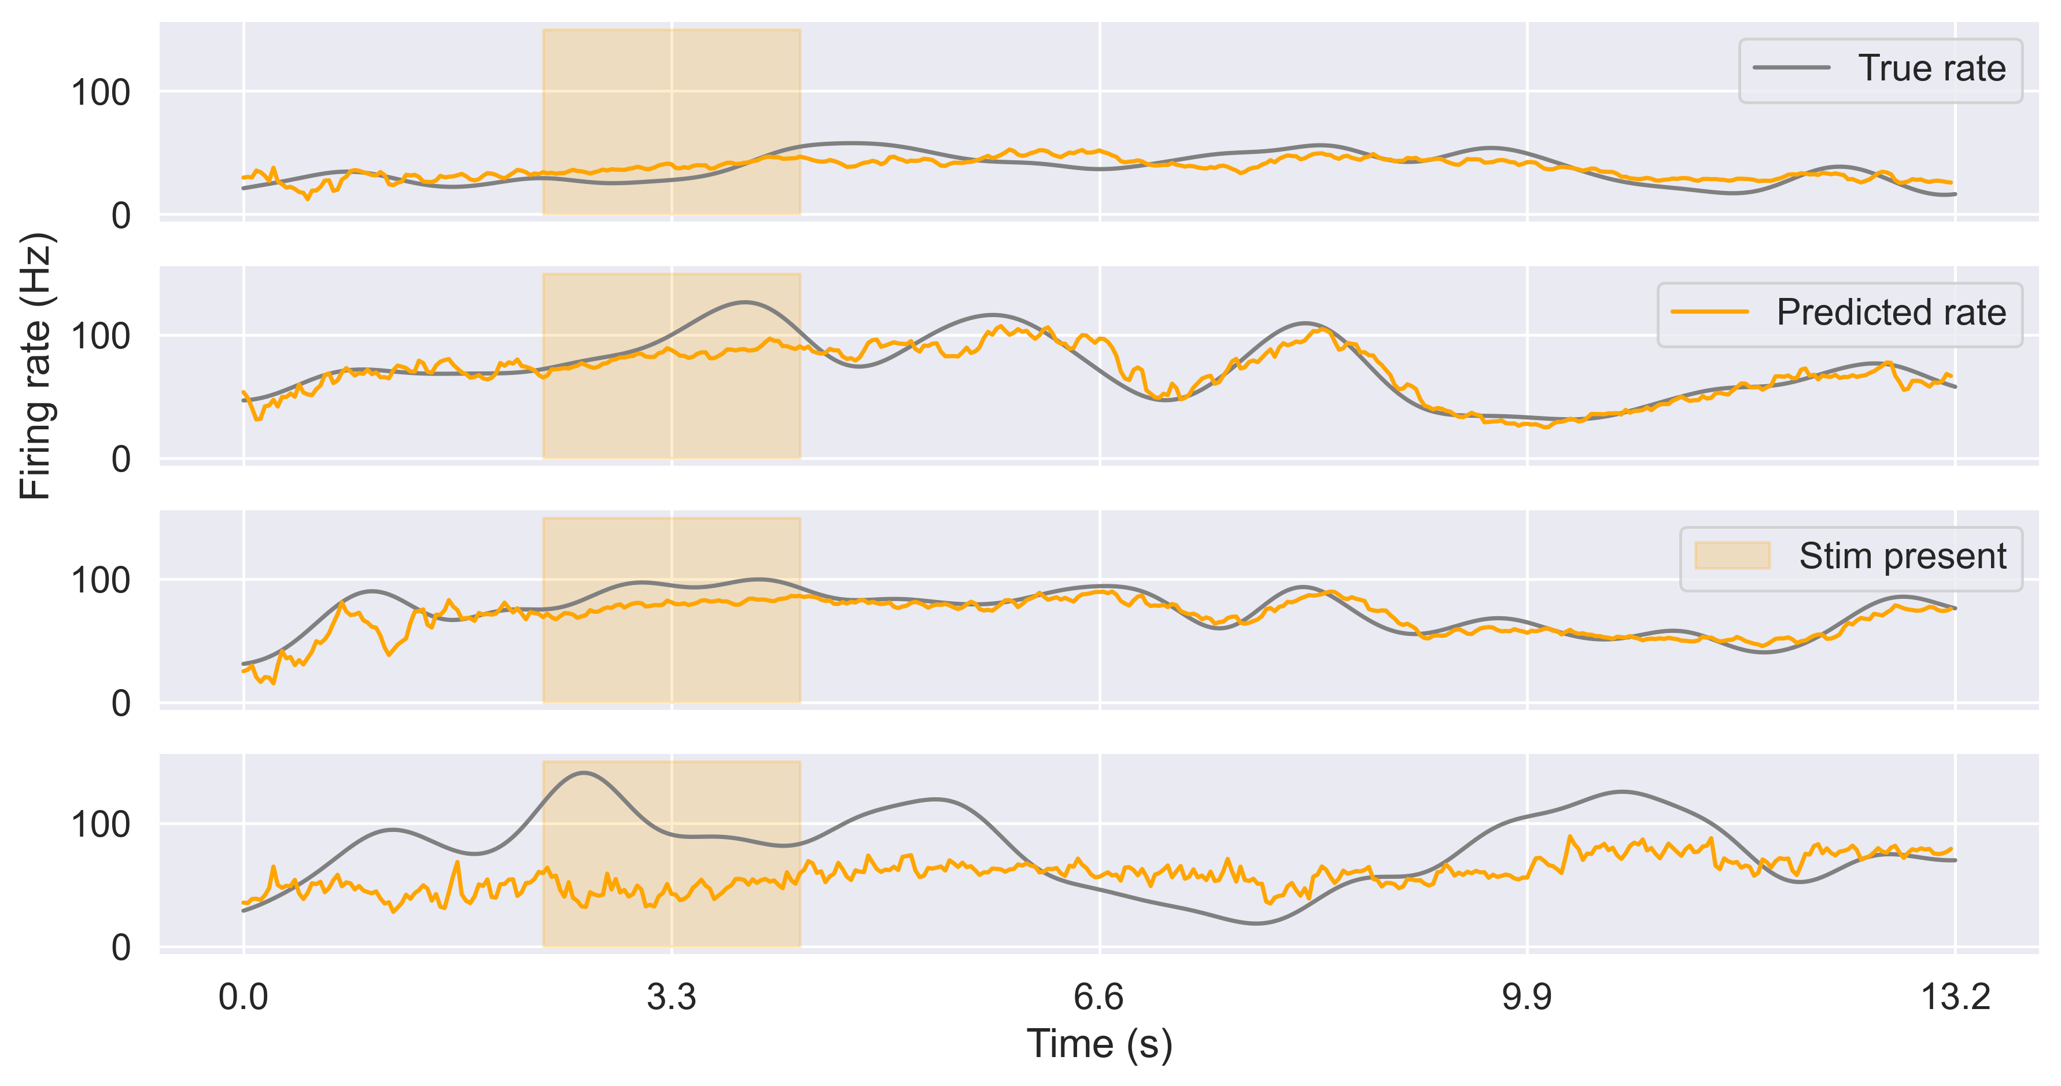
Transformer Learns Neural Circuit with Diverse Stimulation Patterns
S. Liu^{1,2}; A. Mavor-Parker³; E. Baumler⁴; M. Buchholz⁴ & C.Barry¹
¹ UCL Dept of Cell & Developmental Biology. ² The Sainsbury Wellcome Centre. ³ UCL Centre for Artificial Intelligence. ⁴ The Wolfson Institute for Biomedical Research. Equal contribution. Correspondence to caswell.barry@ucl.ac.uk
Introduction. Neural circuits in the brain embody computational functions that are not necessarily apparent from their architecture alone. A possible way to discover this function is to train artificial neural networks, trained with experimental data, to approximate it - distilling the biological function into the artificial weights. This requires experimental observation of neural data passing through the biological circuit, that is, the input and corresponding output. We performed simultaneous two-photon calcium imaging from the hippocampus (CA1) and NeuroPixel recording from the lateral septum (LS) and overlying cortex (CTX) - the former being a significant projection target of CA1. We then trained sets of transformer neural network models on the CA1 – LS circuit. The trained models demonstrated competitive accuracy and efficiency compared to baseline GLMs, and are able to generalise when random stimuli are injected optically into the input neurons.
Simultaneous neural recordings
We simultaneously recorded fluorescence signals (two-photon Ca++ imaging) in hippocampus CA1 as well as multi-unit spiking activities in the LS and CTX (NeuroPixel 2.0).
387 CA1 neurons were imaged via GCaMP, 77 neurons were recorded via Neuropixel probes, of which 13 were from LS and 64 from CTX.
CA1
Light-activated stimuli injection
HPC 7
HPC 126
HPC 268
To test how well a trained transformer model can generalise to non-endogenous activities, we used the all-optical method to ‘inject’ three types of artificial replay sequences into CA1: forward, reverse and random patterns. Performance on the forward patterns exceed that seen for endogeneous patterns
CTX 15
CTX 67
LS 3
Transformer learns endogenous activities
Leveraging the power of transformer neural networks, we use 15 bins sampled at 30Hz (500 ms) of CA1 fluorescence signals to predict 1 bin (33ms) of LS and CTX neuron firing rates. Because of the exponential decay time of the fluorescence signal, the optimal offset was found to be -60ms using a generalized linear model (GLM).
Data efficiency
We trained two transformer models, using 43 mins of CA1 activity to predict LS (where direct projections exist) and CTX (where no direct projections exist) endogenous activities, respectively. Spikes in LS and CTX were smoothed with a Gaussian filter to yield continuous firing rates. The transformer features multi-head attention which can selectively focus on activity at different time points in the CA1 neurons with positional information.
LS 0
LS4
LS 8
CTX 57
To estimate the data efficiency of the transformer and other models, we repeated training with subsampled endogenous data. The transformer outperforms GLM at all levels and continues to improve as more data is provided, whereas GLM flattens out - suggesting significant improvement can be obtained with larger datasets.
Conclusions
Combined optical & electrophysiology datasets are sufficient to allow machine learning methods to approximate biological circuits.
Transformer neural networks can be trained on endogenous activities to functionally approximate the CA1-LS circuit and outperform other methods
Trained model generalises to neural activities where light-activated stimuli are injected externally.
Training transformer is data efficient, and continues to improve when more data is provided.
Predictions in LS captured some of the neural dynamics whereas we observed predictions on many CTX neurons tended towards the mean. Overall the transformer predicted the CA1 – LS circuit 15% better than a baseline GLM and 43% better than predicting the mean alone, using the mean squared error metric. Performance on the direct CA1-LS circuit with marked better than the indirect CA1-CTX circuit.
References
Ólafsdóttir, H. F., Bush, D., & Barry, C. (2018). The role of hippocampal replay in memory and planning. Current Biology, 28(1), R37-R50.
Risold, P. Y., & Swanson, L. W. (1997). Connections of the rat lateral septal complex. Brain research reviews, 24(2-3), 115-195.
Vaswani, A., Shazeer, N., Parmar, N., Uszkoreit, J., Jones, L., Gomez, A. N., ... & Polosukhin, I. (2017). Attention is all you need. Advances in neural information processing systems, 30.

